Slide 1
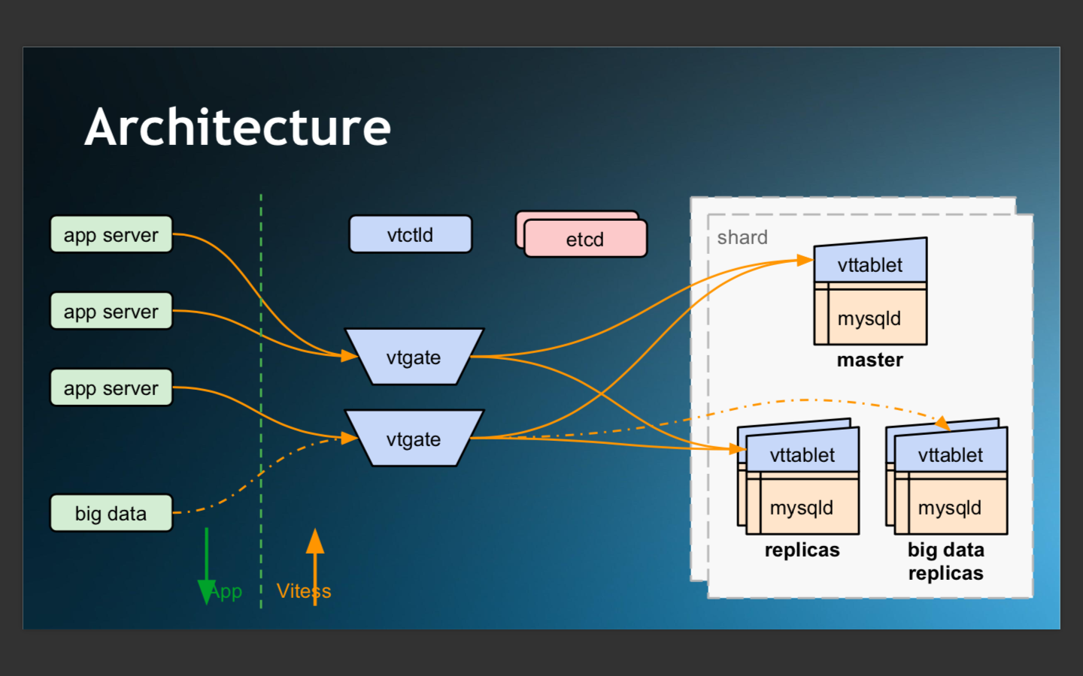

Slide 2
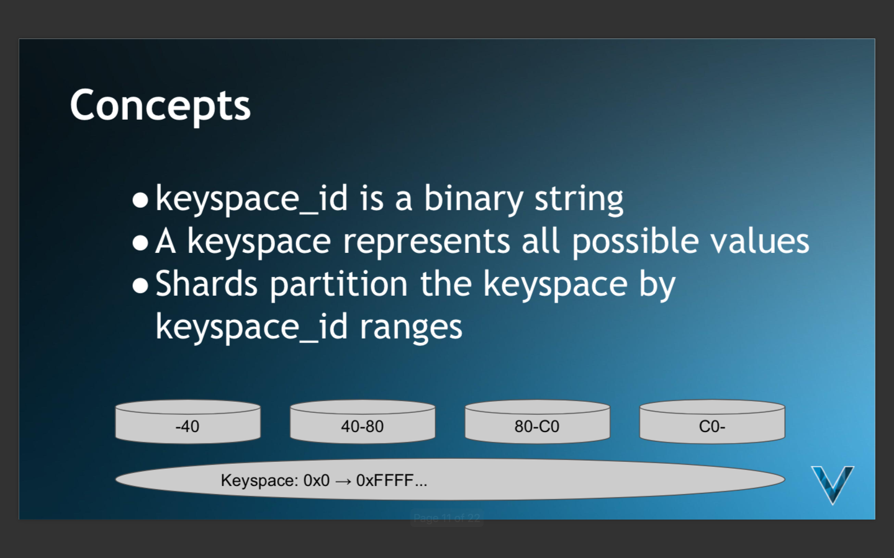

Slide 3
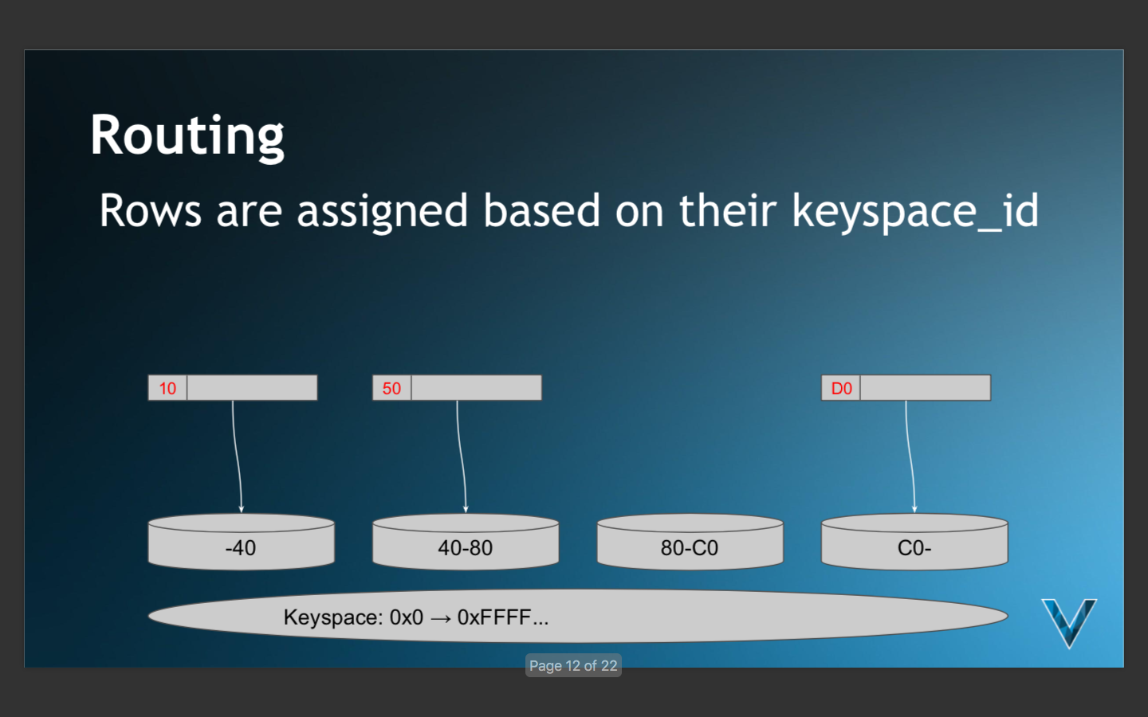

Slide 4
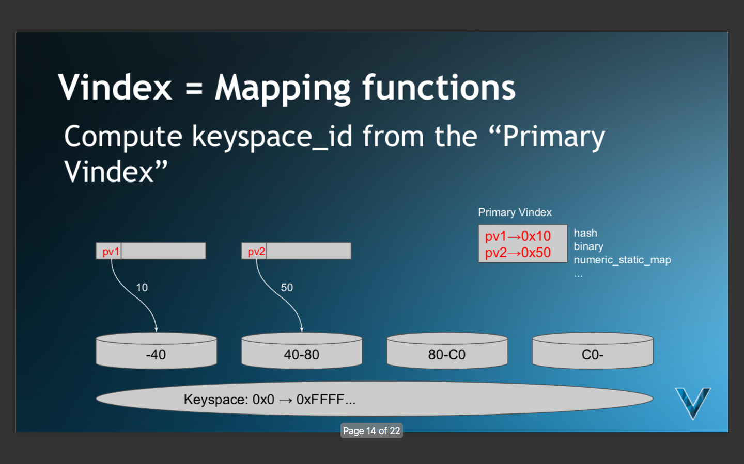

Slide 5
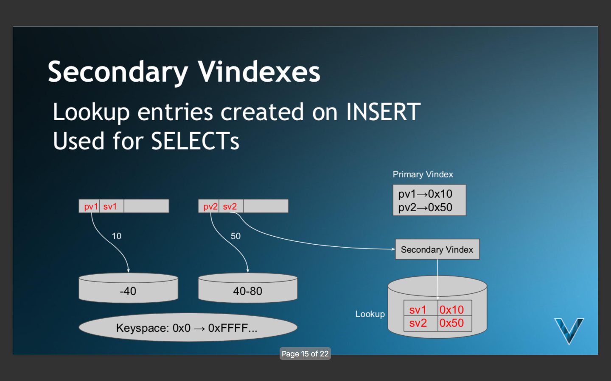

Slide 6
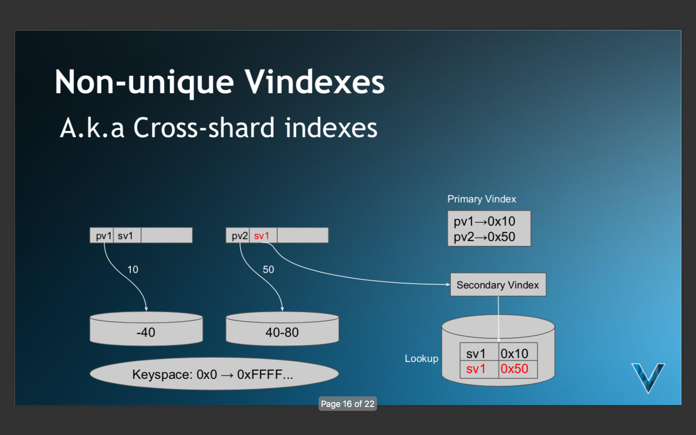

Slide 7
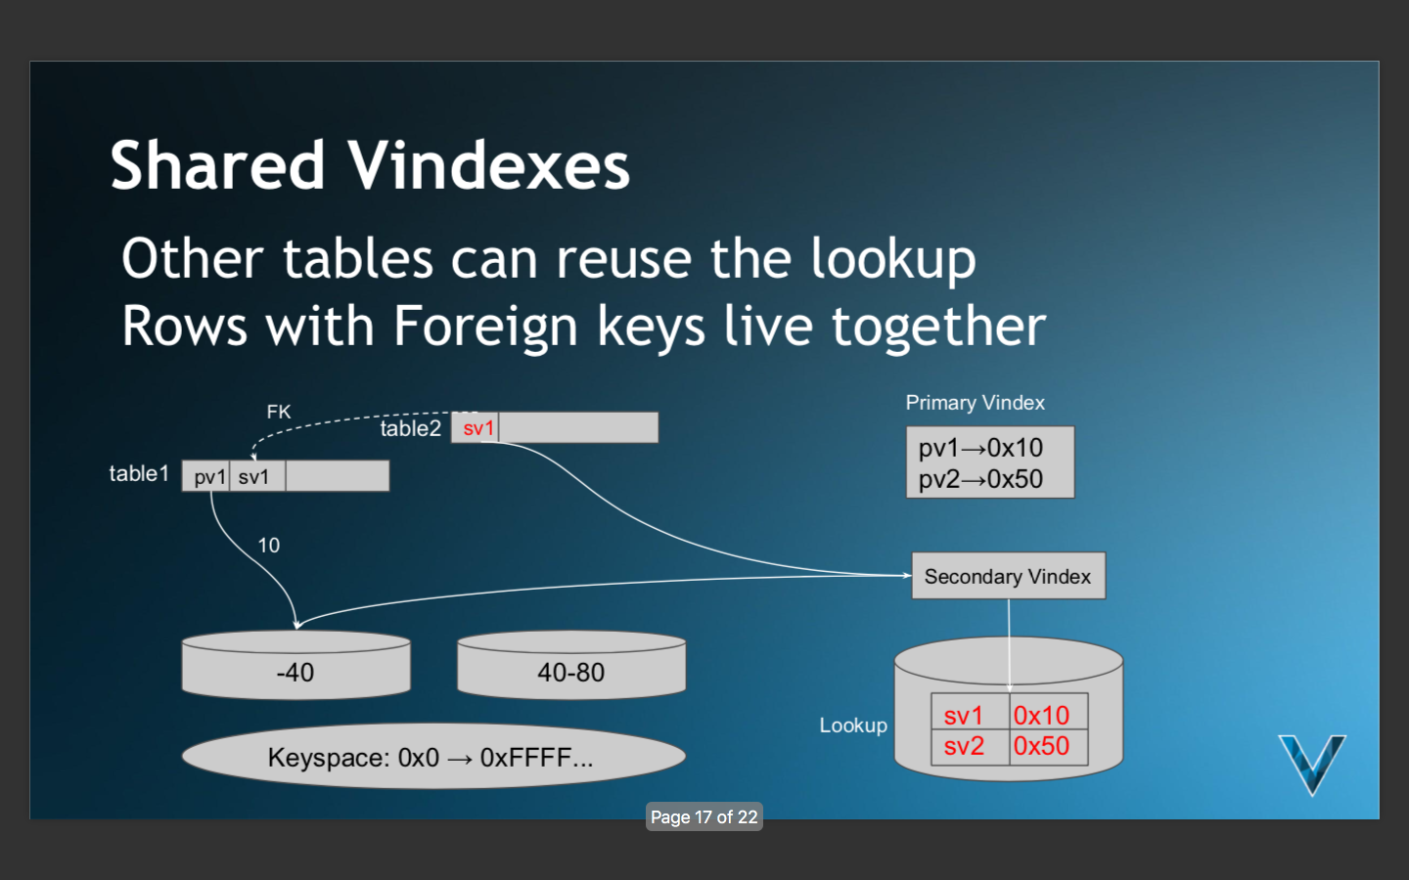

Slide 8
Category
Product_category_mappings
Product

Slide 9
Category
Product_category_mappings
Product
Category_id_vindex

Slide 10
Category
Product_category_mappings
Product
Category_id_vindex
Product_id_vindex

Slide 11
Category
Product_category_mappings
Product
Category_id_vindex
Product_id_vindex

Slide 12
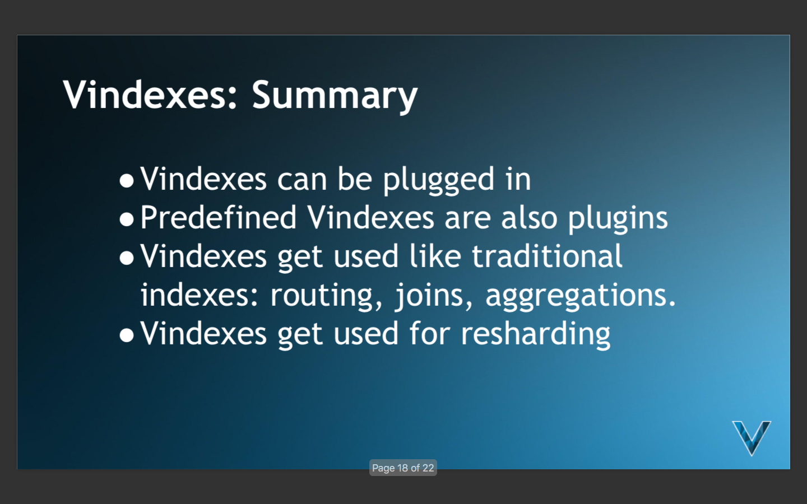

Slide 13
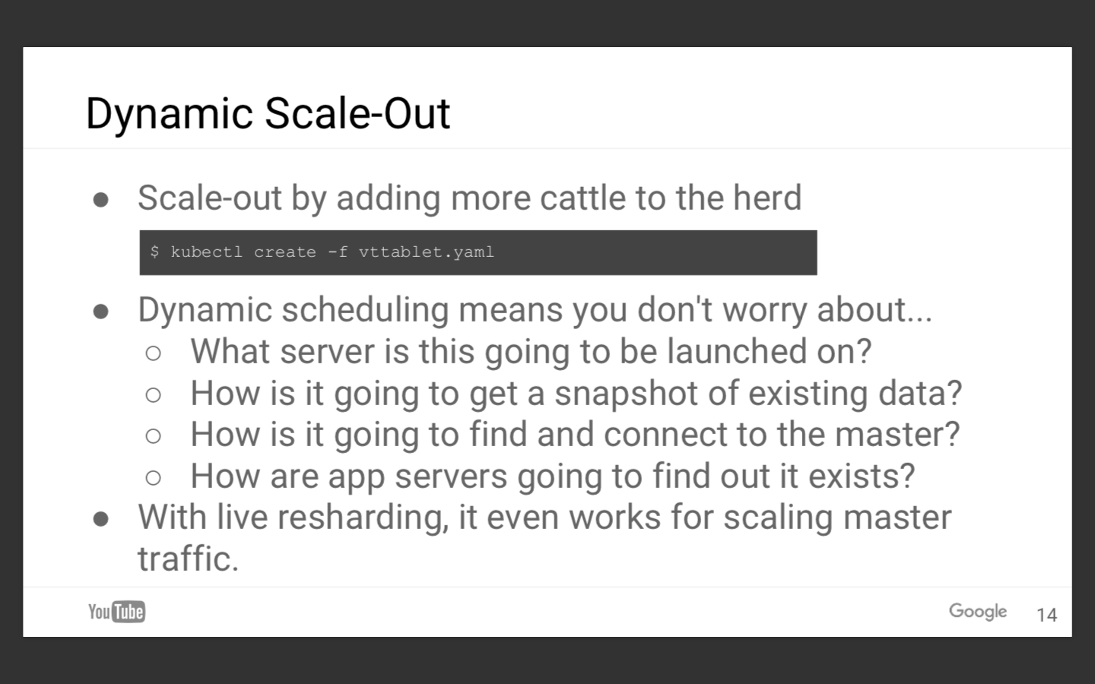

Slide 14
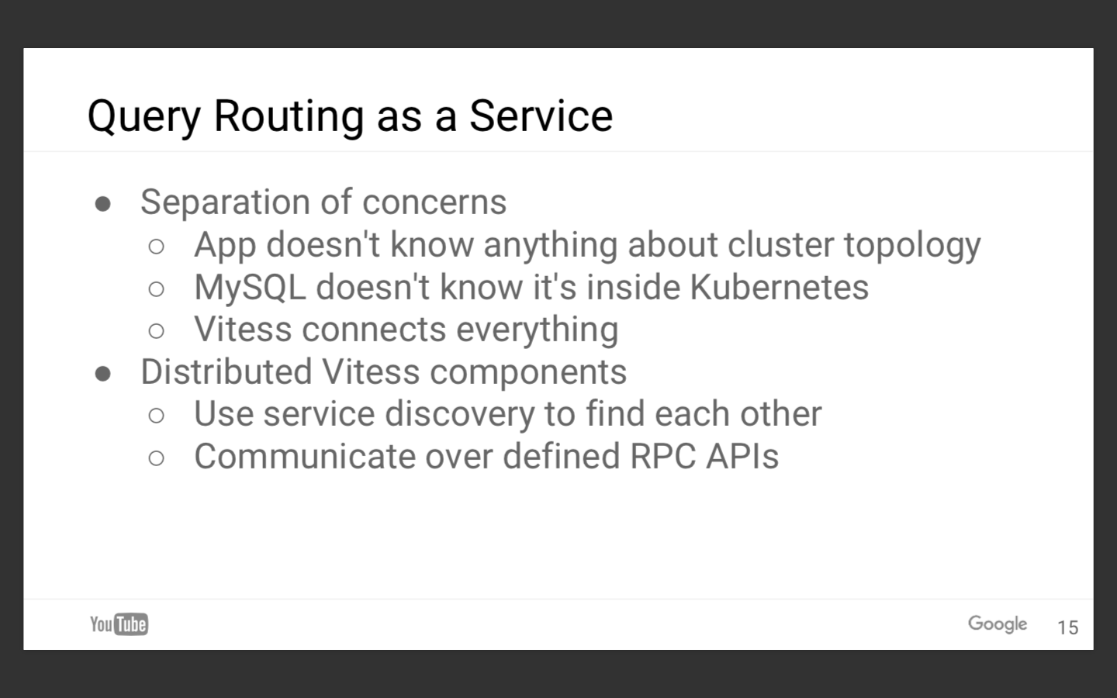

Slide 15
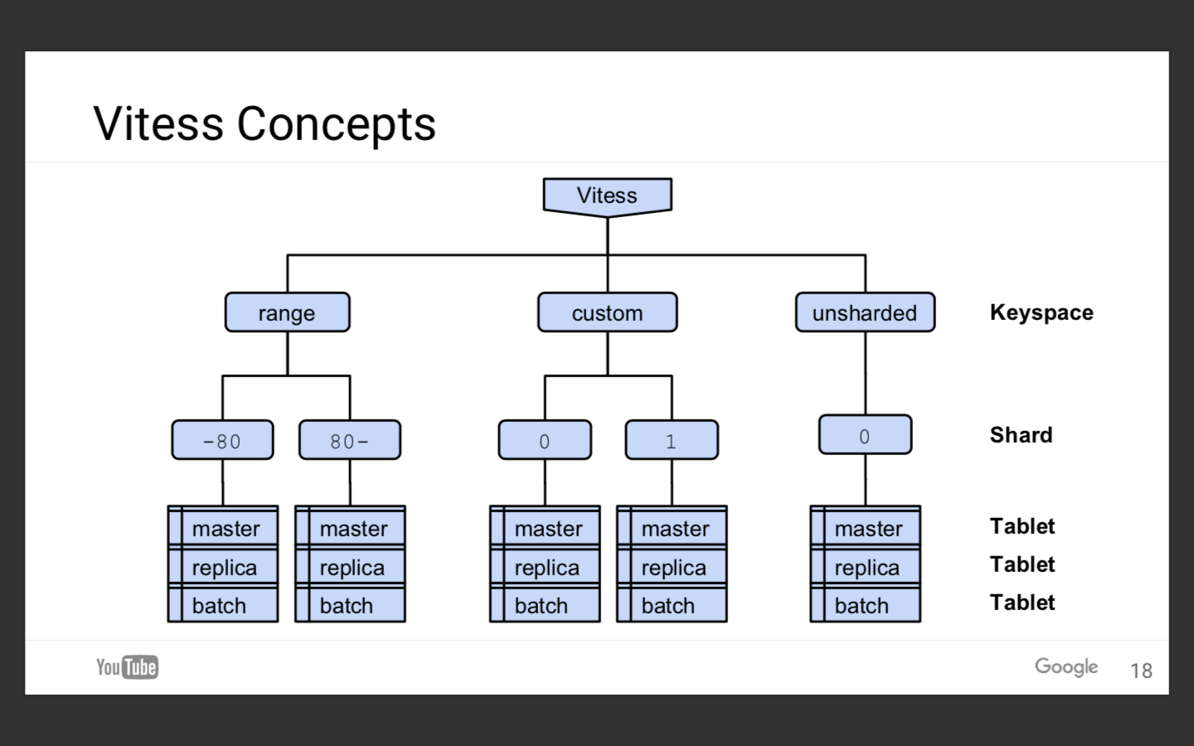

Slide 16
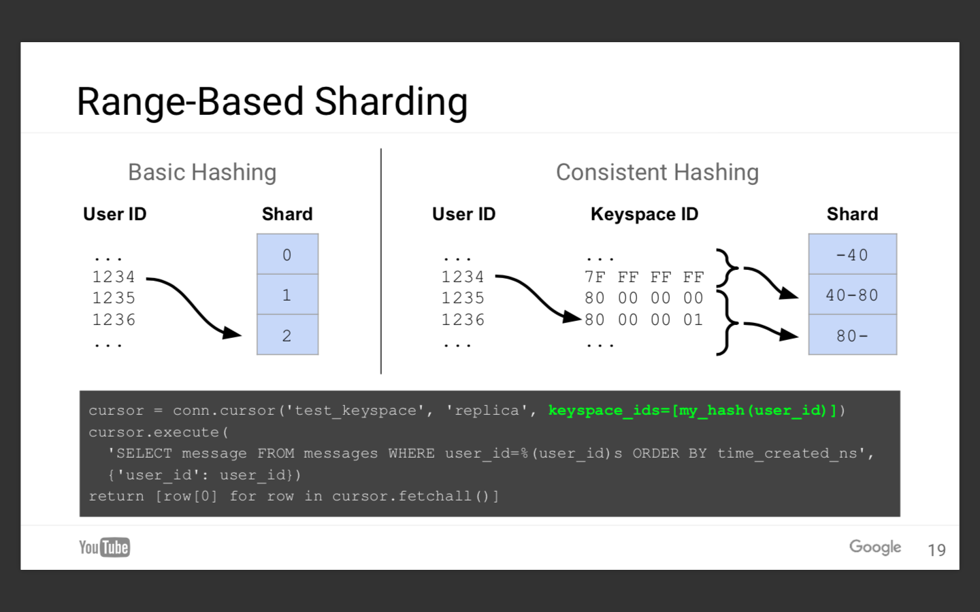

Slide 17
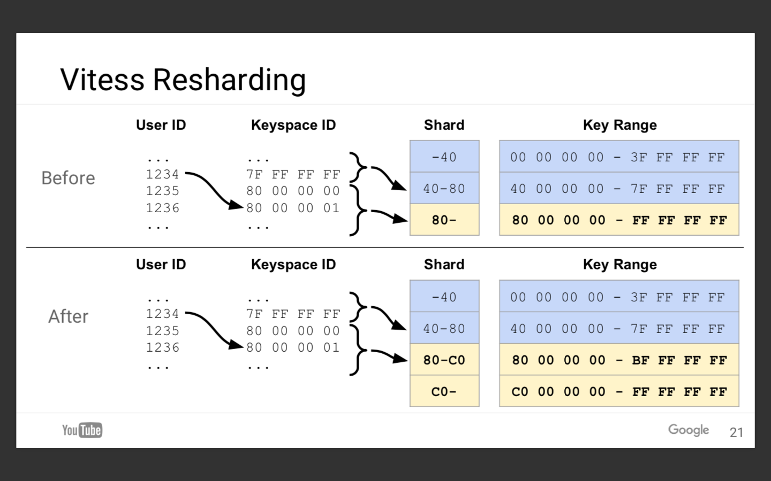

Slide 18
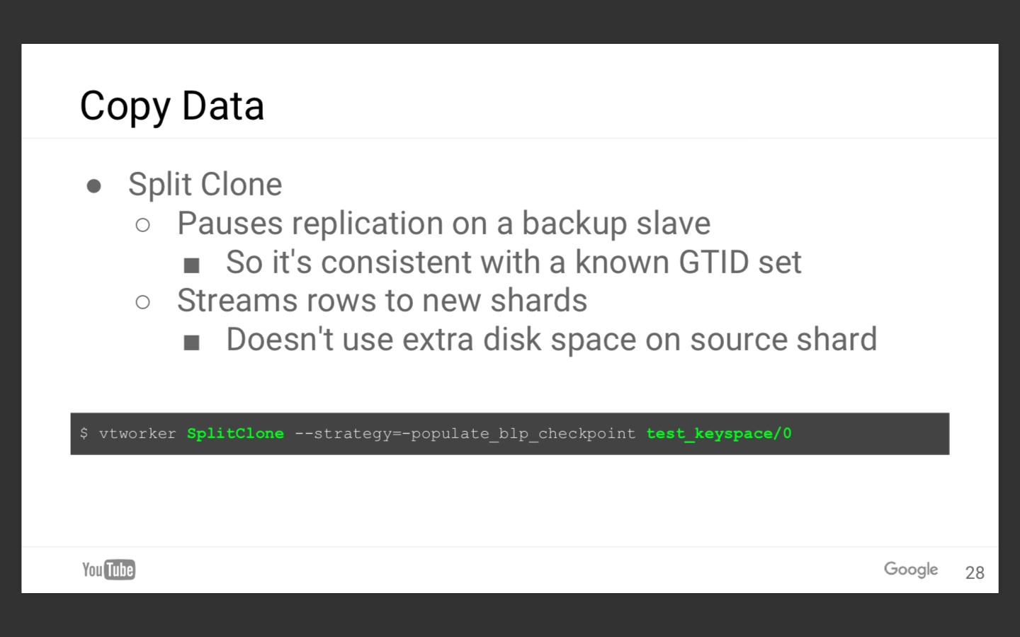

Slide 19
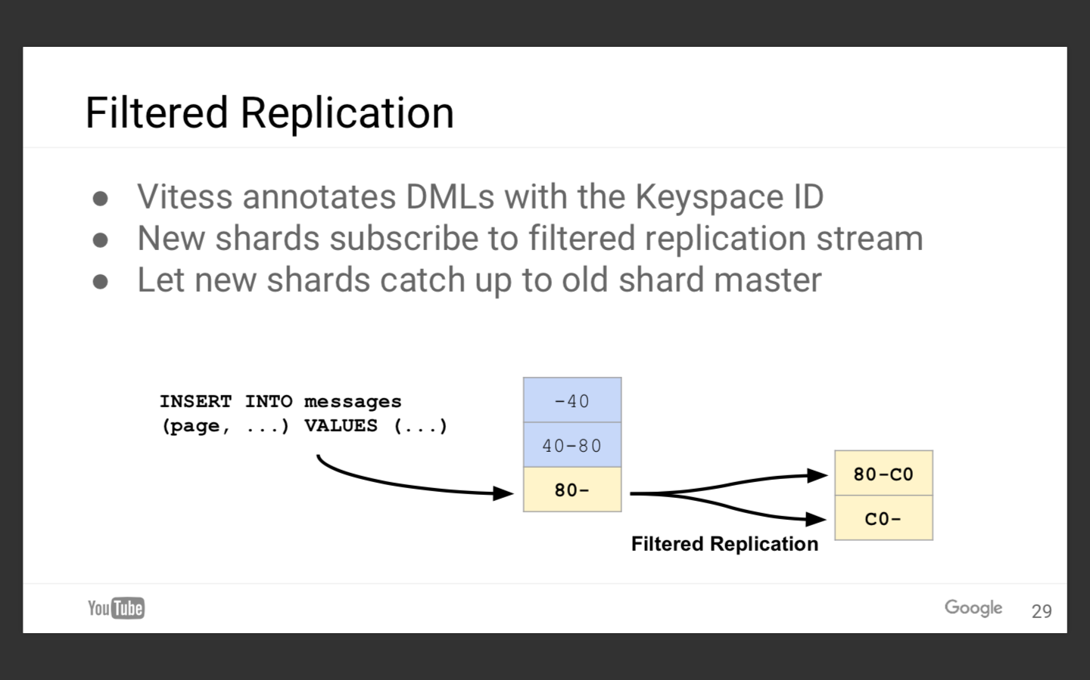

Slide 20
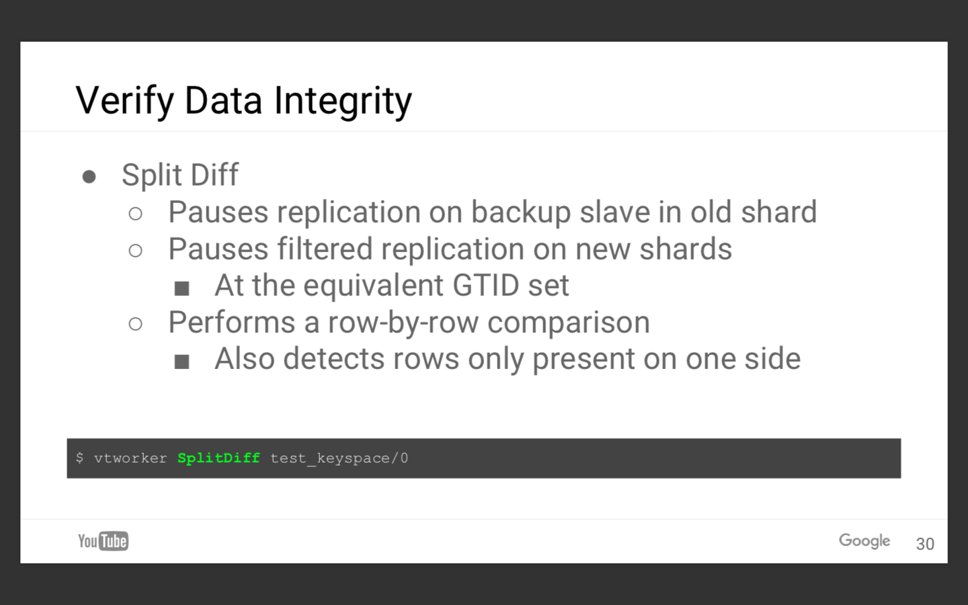

Slide 21
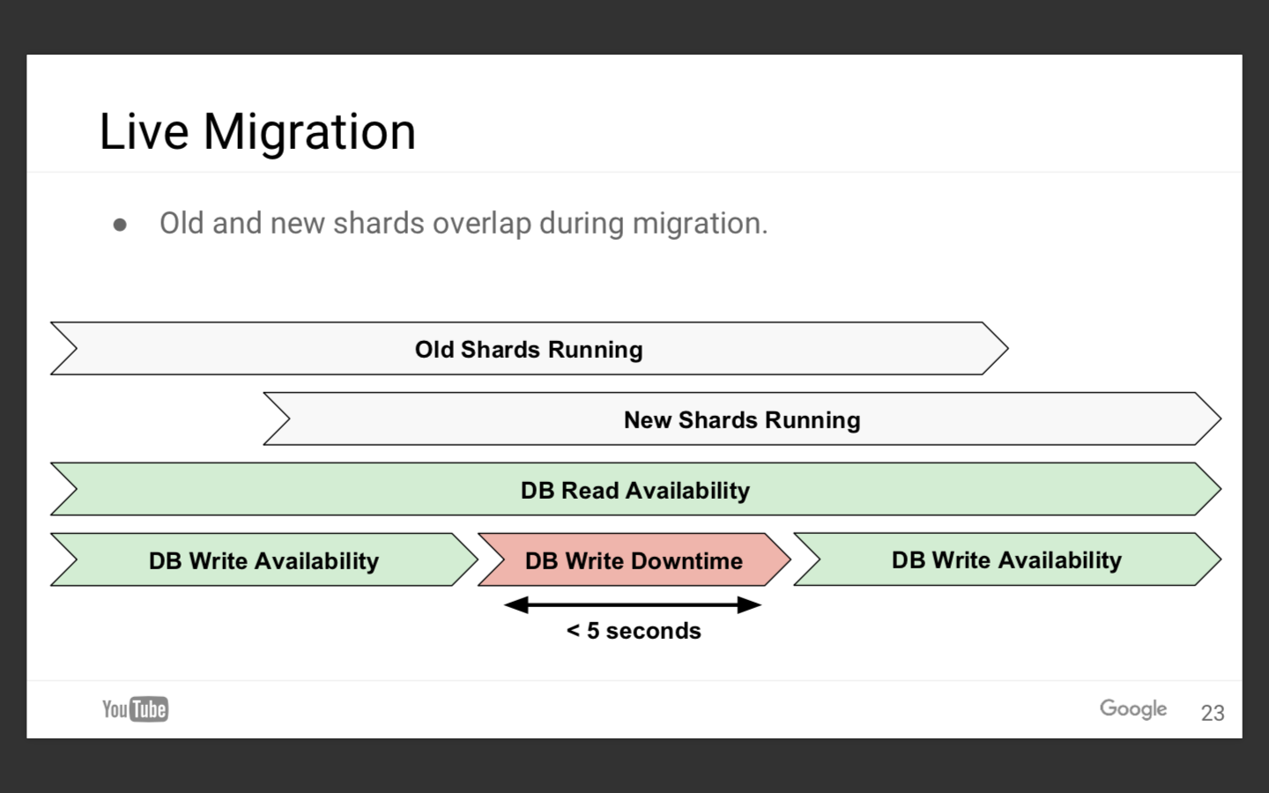

Slide 22
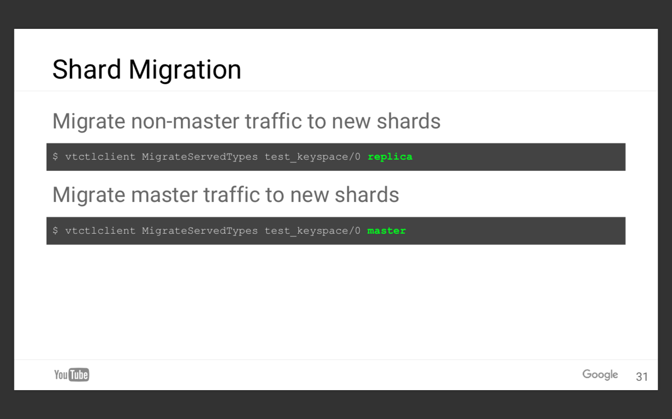

Slide 23
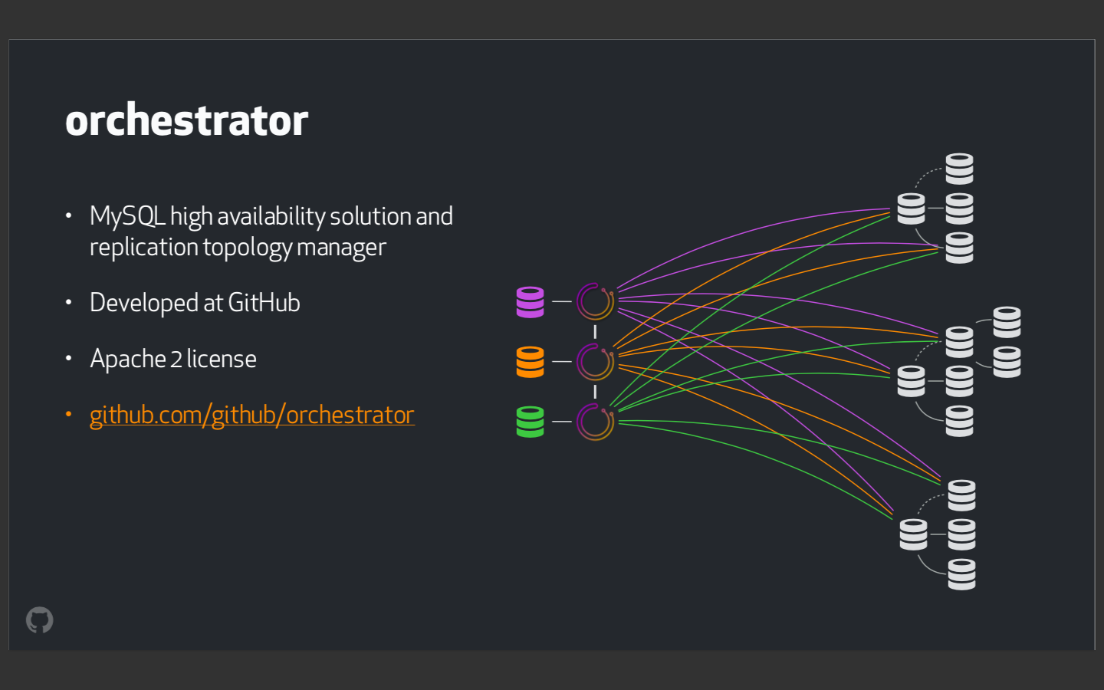

Slide 24
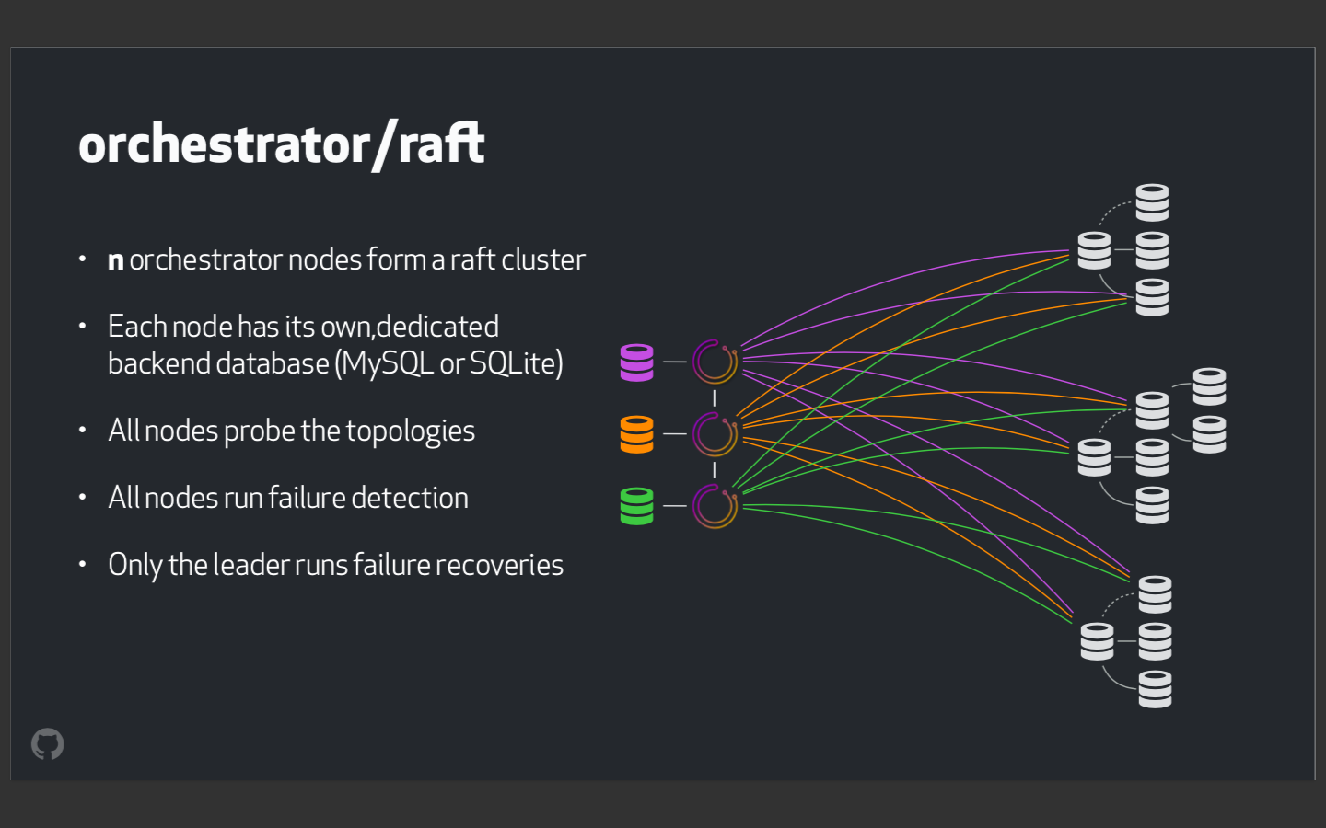

Slide 25
Kubernetes Concepts - Core
Cluster - A collection of hosts that aggregate their available resources including cpu, ram, disk, and their devices into a usable pool.
Master - The master(s) represent a collection of components that make up the control plane of Kubernetes. These components are responsible for all cluster decisions including both scheduling and responding to cluster events.
Node - A single host, physical or virtual capable of running pods. A node is managed by the master(s), and at a minimum runs both kubelet and kube-proxy to be considered part of the cluster.
Namespace - A logical cluster or environment. Primary method of dividing a cluster or scoping access.
Notes:
WIth the API, the namespace actually translates to part of the URI and allows for easy scoping of access

Slide 26
Concepts - Core (cont.)
Label - Key-value pairs that are used to identify, describe and group together related sets of objects. Labels have a strict syntax and available character set. *
Annotation - Key-value pairs that contain non-identifying information or metadata. Annotations do not have the the syntax limitations as labels and can contain structured or unstructured data.
Selector - Selectors use labels to filter or select objects. Both equality-based (=, ==, !=) or simple key-value matching selectors are supported.
* https://kubernetes.io/docs/concepts/overview/working-with-objects/labels/#syntax-and-character-set
Notes:
Labels, Annotations, and Selectors are heavily used in K8s
Part of the design principles of kubernetes was being able to reference other objects without having to know the object’s name directly and all these play into it
Annotations are used quite a bit by various extensions for additional config information

Slide 27
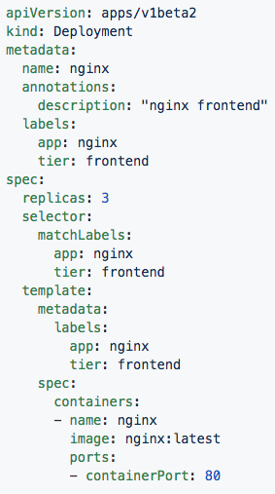
Labels, and Annotations, and Selectors
Labels:
app: nginx
tier: frontned
Annotations
description: “nginx frontend”
Selector:
app: nginx
tier: frontend
Notes:
In this both the Deployment and Pod are labeled with app:nginx, tier: frontend
The replicaset definition targets them with simple selectors matching the key-value pairs of both app:nginx and tier: frontend

Slide 28
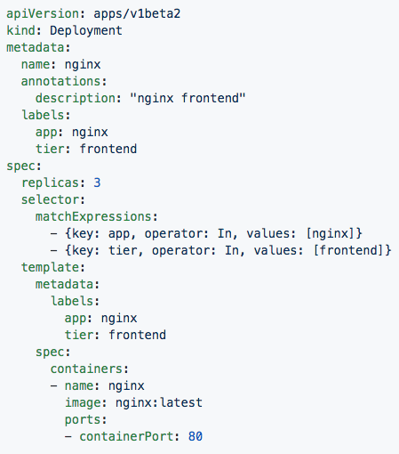
Set-based selectors
Valid Operators:
In
NotIn
Exists
DoesNotExist
Supported Objects with set-based selectors:
Job
Deployment
ReplicaSet
DaemonSet
PersistentVolumeClaims
Notes:
Set-based selectors are a bit more advanced allowing you to match against possible values and use some boolean logic
Only a subset of objects support these set-based selectors

Slide 29
Concepts - Workloads
Pod - A pod is the smallest unit of work or management resource within Kubernetes. It is comprised of one or more containers that share their storage, network, and context (namespace, cgroups etc).
ReplicationController - Method of managing pod replicas and their lifecycle. Their scheduling, scaling, and deletion.
ReplicaSet - Next Generation ReplicationController. Supports set-based selectors.
Deployment - A declarative method of managing stateless Pods and ReplicaSets. Provides rollback functionality in addition to more granular update control mechanisms.
Notes:
The Pod is the atomic unit of k8s -- in the Deployment on the previous side, the Pod was in the spec.template

Slide 30
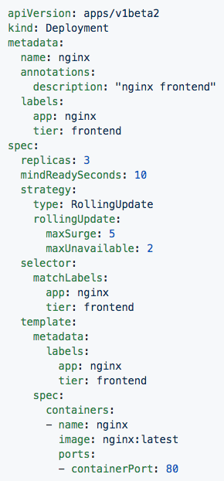
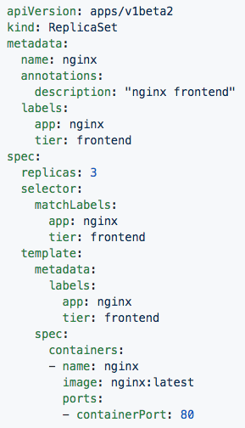
Deployment
ReplicaSet
Contains configuration of how updates or ‘deployments’ should be managed in addition to the pod template used to generate the ReplicaSet.
Generated ReplicaSet from Deployment spec.
Notes:
Deployments define how a replicaset is to be updated, and can also retain information on rolling back.
Replicasets simply manage the how many replicas of a pod should be running and healthy etc

Slide 31
Concepts - Workloads (cont.)
StatefulSet - A controller tailored to managing Pods that must persist or maintain state. Pod identity including hostname, network, and storage will be persisted.
DaemonSet - Ensures that all nodes matching certain criteria will run an instance of a supplied Pod. Ideal for cluster wide services such as log forwarding, or health monitoring.

Slide 32
Concepts - Workloads (cont.)
Job - The job controller ensures one or more pods are executed and successfully terminates. It will do this until it satisfies the completion and/or parallelism condition.
CronJob - An extension of the Job Controller, it provides a method of executing jobs on a cron-like schedule.

Slide 33
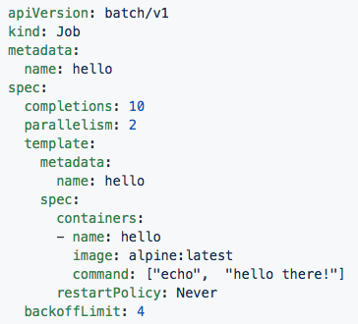
Jobs
Number of pod executions can be controlled via spec.completions
Jobs can be parallelized using spec.parallelism
Jobs and Pods are NOT automatically cleaned up after a job has completed.
Notes:
This will run the container 10 times “echoing hello there”, running 2 at a time
As a note, completions is not guaranteed, its possible for it to run it more than 10 times under certain conditions.
They are not cleaned up so if you need to get at logs or do something with the pods you can.
There are also some current limitations with jobs in that it requires all containers within the pod to complete, this poses a problem for sidecar containers, but is in the works for being resolved

Slide 34
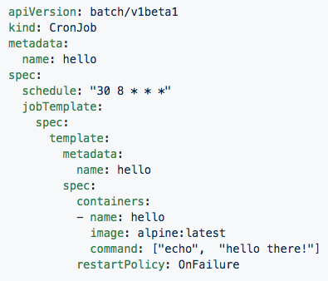
CronJob
Adds cron schedule to job template
Notes:
jobTemplate is simply the job spec, schedule is slapped on top of it

Slide 35
Concepts - Network
Service - Services provide a method of exposing and consuming L4 Pod network accessible resources. They use label selectors to map groups of pods and ports to a cluster-unique virtual IP.
Ingress - An ingress controller is the primary method of exposing a cluster service (usually http) to the outside world. These are load balancers or routers that usually offer SSL termination, name-based virtual hosting etc.

Slide 36
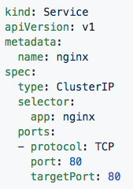
Service
Acts as the unified method of accessing replicated pods.
Four major Service Types:
CluterIP - Exposes service on a strictly cluster-internal IP (default)
NodePort - Service is exposed on each node’s IP on a statically defined port.
LoadBalancer - Works in combination with a cloud provider to expose a service outside the cluster on a static external IP.
ExternalName - used to references endpoints OUTSIDE the cluster by providing a static internally referenced DNS name.
Notes:
LoadBalancer requires an external provider, and in the alpha deployment stuff this is where keepalived fits in.
Not the best term to be used to reference an externalIP, but when you think cloud first, thats the ingress you’re going to use
You can attach an externalIP to a service directly without an LB, but you must know the IP ahead of time, it cannot pool from an available pool like LB can
One other interesting note, since services are virtualIPs managed by kube-proxy, they will only respond to the ports that are open whereas a Pod’s unique IP will without any any network policies respond to all ports and protocols

Slide 37
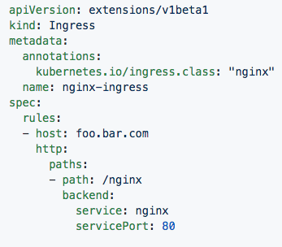
Ingress Controller
Deployed as a pod to one or more hosts
Ingress controllers are an external controller with multiple options.
Nginx
HAproxy
Contour
Traefik
Specific features and controller specific configuration is passed through annotations.
Notes:
Ingress controllers are fundamentally a k8s extension
You can have mutliple types in your cluster and use annotations to determine which one you wish to use
They are generally used for http, but can be used to route bot straight tcp and udp

Slide 38
Concepts - Storage
Volume - Storage that is tied to the Pod Lifecycle, consumable by one or more containers within the pod.
PersistentVolume - A PersistentVolume (PV) represents a storage resource. PVs are commonly linked to a backing storage resource, NFS, GCEPersistentDisk, RBD etc. and are provisioned ahead of time. Their lifecycle is handled independently from a pod.
PersistentVolumeClaim - A PersistentVolumeClaim (PVC) is a request for storage that satisfies a set of requirements instead of mapping to a storage resource directly. Commonly used with dynamically provisioned storage.
StorageClass - Storage classes are an abstraction on top of an external storage resource. These will include a provisioner, provisioner configuration parameters as well as a PV reclaimPolicy.
Notes:
Things can get a little confusing here, big thing to note:
A volume in a pod definition is tied to the pods lifecycle, it dies when the pod dies
A PV is a cluster-wise resource, usually some external storage system.
A PVC maps to a request for storage from a PV or StorageClass.

Slide 39
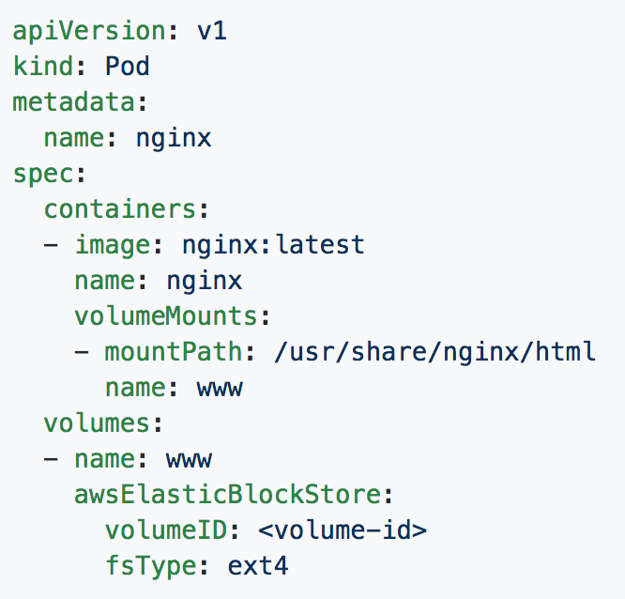
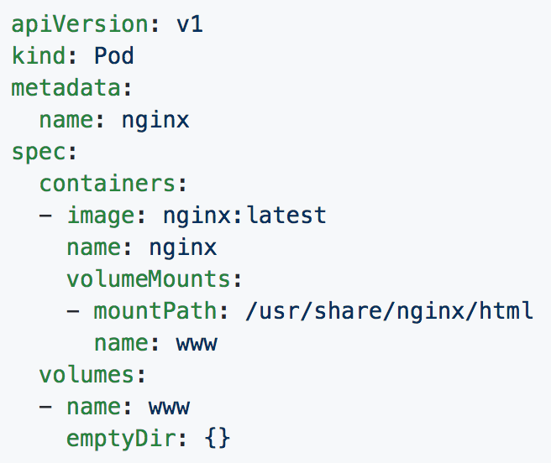
Volumes
Notes:
You will see emptydir quite a bit, it is one of the commonly used methods of sharing between containers within a pod
The example with aws is a bad one, but sufficient, if you needed to attach significant storage to a pod as say scratch space, thatd be how

Slide 40
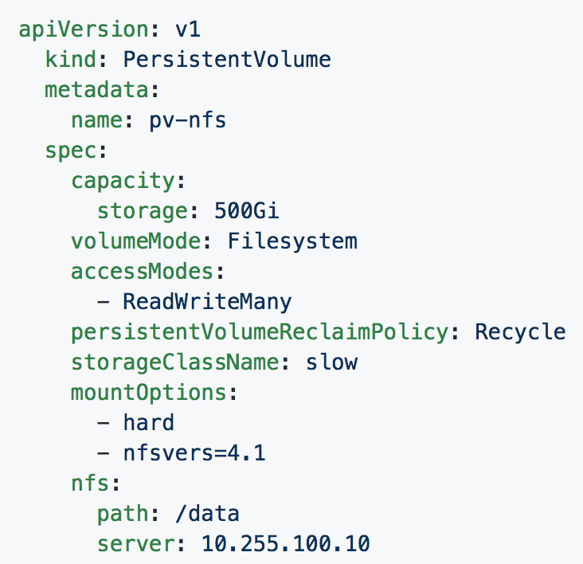
Persistent Volumes
PVs are a cluster-wide resource
Not directly consumable by a Pod
PV Parameters:
Capacity
accessModes
ReadOnlyMany (ROX)
ReadWriteOnce (RWO)
ReadWriteMany (RWX)
persistentVolumeReclaimPolicy
Retain
Recycle
Delete
StorageClass
Notes:
Capacity - how much it has to use
AccessMode - how it can be accessed, multiple modes can be specified
Mount readonly to every pod binding to it
read/write once to the 1st entity that binds to it
read/write for every pod binding to int
Reclaim policy - how it is cleaned up
Retain - requires manual removal
Recycle - performs a simple scrub like rm -rf
Delete - the associated storage asset is deleted
Storageclass - how it can be searched for easily and used any pvc referncing the storageclass slow would then use this behind the scenes

Slide 41
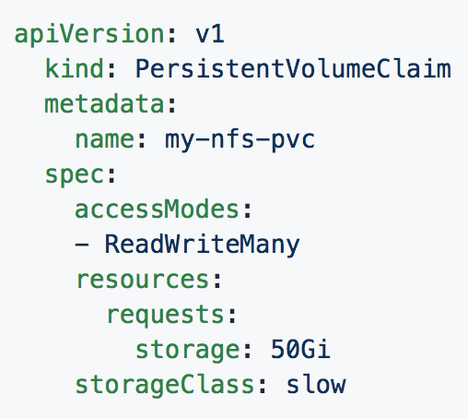
Persistent Volume Claims
PVCs are scoped to namespaces
Supports accessModes like PVs
Uses resource request model similar to Pods
Claims will consume storage from matching PVs or StorageClasses based on storageClass and selectors.
Notes:
PVC are show you should consume storage
You can use selectors as you would with services deployments etc instead of specifying storageClass

Slide 42
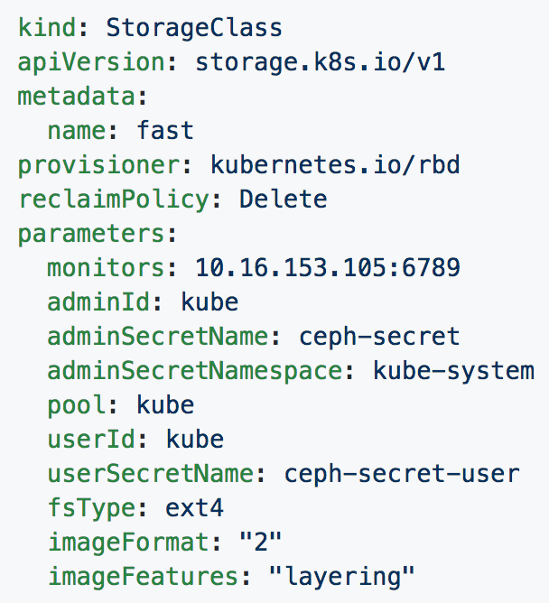
Storage Classes
Uses an external system defined by the provisioner to dynamically consume and allocate storage.
Storage Class Fields
Provisioner
Parameters
reclaimPolicy
Notes:
StorageClass maps to an external entity that can provide dynamic storage
Provisioner is a reference to what plugin is needed for the external storage system
reclaimPolicy is just as we’ve seen it before with PV and PVCs
Parameters is the plugin or driver specific configuration
Many of the storage systems are moving to this model instead of manually provisioning pvs or relying on a cloud controller to do it

Slide 43
Concepts - Configuration
ConfigMap - Externalized data stored within kubernetes that can be referenced as a commandline argument, environment variable, or injected as a file into a volume mount. Ideal for separating containerized application from configuration.
Secret - Functionally identical to ConfigMaps, but stored encoded as base64, and encrypted at rest (if configured).
Notes:
Note the base64 thing with secrets

Slide 44
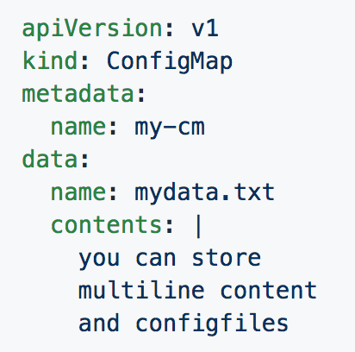
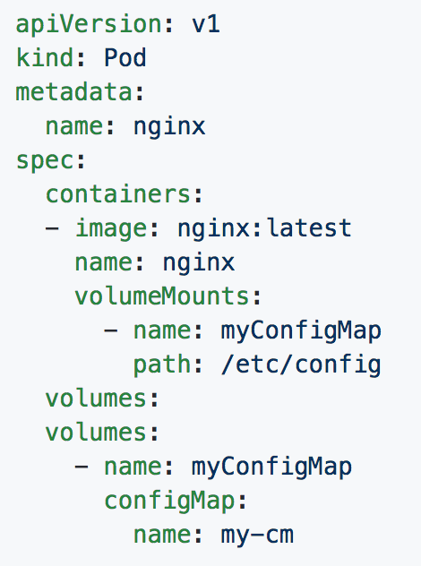
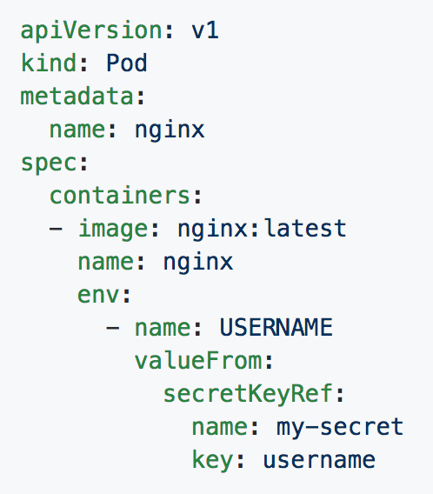
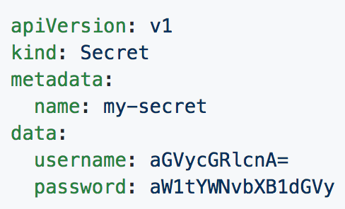
ConfigMaps and Secrets
Can be used in Pod Config:
Injected as a file
Passed as an environment variable
Used as a container command (requires passing as env var)
Notes:
Top right is a confgmap
Bottom right is a secret
Bottom left passes it to a volume
Bottom middle injects it as an env var

